Slide 1

AI-Driven Border Security And Strategic Management System
Group Members:
Geddada Harshith
Kesavardhan Makkireddi
Rachakatla Sai Varshith
Praneeth Kumar Ganji
Guided by: Mr. Pravin S. Bhagat

Slide 2
CONTENTS
PROBLEMS FACED IN BORDER SECURITY
LITERATURE REVIEW
OBJECTIVES
METHODOLOGY
RESULTS
FUTURE WORK & CONCLUSION
REFERENCES

Slide 3
PROBLEMS FACED IN BORDER SECURITY
Manual Surveillance Limitations: Border personnel monitor vast areas manually, leading to fatigue and errors. Limited human attention span impacts the consistency of threat detection. Manual Surveillance Limitations: Border personnel monitor vast areas manually, leading to fatigue and errors. Limited human attention span impacts the consistency of threat detection. Lack of Real-Time Pattern Detection: Difficulty in identifying unusual patterns or behaviors in surveillance footage. Existing systems struggle to adapt to dynamic scenarios such as occlusions or crowd density. Limited Intelligence Sharing: Soldiers may lack access to criminal profiles or past behavior data. Tracking individuals across multiple areas or cameras is inconsistent.

Slide 4
LITERATURE REVIEW
1. YOLORe-IDNet: An Efficient Multi-Camera System for Person Tracking (2022) This paper introduced YOLORe-IDNet, a system that combines person re-identification (Re-ID) and object detection into a single framework. The system effectively tracked individuals across multiple cameras using a modified YOLO architecture. Trained on the Market-1501 dataset and custom surveillance datasets, the system achieved great accuracy for re-identification across different camera views. Its strength lies in handling dense environments.

Slide 5
LITERATURE REVIEW
2. Weapon Detection Using Deep Learning Models and Artificial Intelligence (2023) This study focused on developing a weapon detection system using deep learning models, primarily Faster R-CNN, to achieve real-time detection in surveillance environments. The authors trained their models on a dataset containing various weapons and non-weapon objects, achieving a precision of 88% and recall of 85%. Despite its high accuracy in controlled conditions, challenges arose in detecting small or partially obscured weapons.

Slide 6
LITERATURE REVIEW
3. Real-Time Crime Detection by Captioning Video Surveillance Using Deep Learning (2023) IJCRT. This research proposed an innovative approach to automate crime detection by generating textual captions for surveillance footage using Transformer-based deep learning models. Trained on the UCF Crime Dataset, the system achieved an 84% accuracy in describing real-time events, including anomalies like fights or suspicious movements. However, it noted limitations in handling ambiguous or low-resolution video feeds.

Slide 7
LITERATURE REVIEW
4. Weapon Detection System for Surveillance and Security (2022) The authors developed a hybrid weapon detection system that combined YOLO for real-time detection and SVM for anomaly detection. The system was trained on the COCO dataset and a curated dataset of concealed weapons, achieving 87% precision and 82% recall. It proved effective under varied lighting conditions but struggled with heavily overlapping objects. The paper suggested that such systems could be instrumental in enhancing real-time monitoring at border checkpoints and security-sensitive areas.

Slide 8
OBJECTIVES
Real-Time Threat Detection:
Develop an AI-based system capable of identifying weapons and classifying individuals in real-time using surveillance video feeds.
Weapon Identification:
Accurately detect and classify weapons, including pistols, rifles, and knives, under diverse environmental conditions.
Individual Classification:
Distinguish between soldiers and terrorists using facial recognition and classification algorithms.
Multi-Camera Integration:
Integrate multiple surveillance camera feeds into a unified system for continuous tracking and monitoring.
Real-Time Alerts:
Generate instant alerts for security personnel when potential threats are detected, improving response time
Minimize False Positives:
Implement a whitelist mechanism to recognize authorized personnel (e.g., security guards or soldiers with weapons) and reduce false alarms.

Slide 9
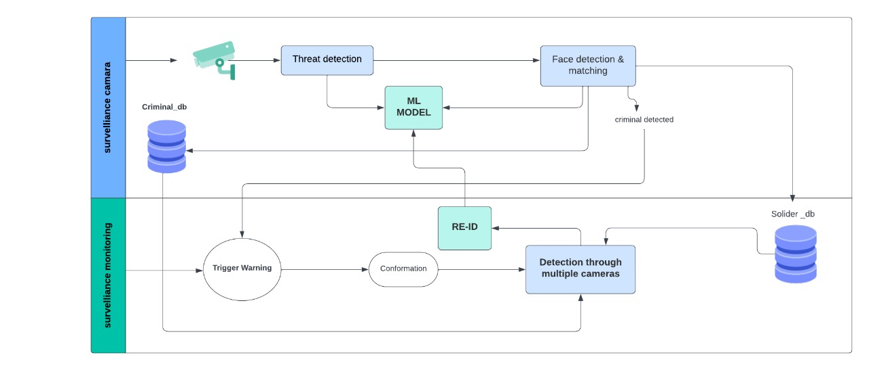
METHODOLOGY

Slide 10
METHODOLOGY
Data Preparation:
Collected and curated custom datasets:
Weapon Detection Dataset: Included images of pistols, rifles, and knives.
Person Classification Dataset: Faces labeled as "Soldiers" or "Terrorists.“
Annotated data using bounding boxes (YOLO format) for object detection.
Preprocessing:
YOLO will
Image Resizing: Adjusted input dimensions to match model requirements.
Data Augmentation: Enhanced dataset diversity with transformations like flipping, rotation, and brightness adjustment.
Normalization: Scaled pixel values for consistent model input.
Model Selection and Training:
Chose YOLOv8 for fast and accurate object detection.
Trained separate models for:
Weapon Detection (Pistols, rifles, knives).
Person Classification (Soldiers vs. Terrorists).
Utilized NVIDIA GPU for accelerated training.

Slide 11
METHODOLOGY
System Integration:
Integrated components into a unified system:
Multi-camera feeds using Webcam (or) IP Webcam for real-time input.
Combined detection results into a cohesive threat assessment.
Real-Time Operation:
Deployed the system to process live video streams.
Triggered instant alerts upon detecting weapons or threats.
Evaluation:
Assessed model performance using metrics:
Precision, Recall, and F1-Score for detection accuracy.
Confusion matrices to visualize classification performance.
Outputs:
System-generated labels for:
Weapons detected.
Classification of individuals as "Soldiers" or "Terrorists."
Real-time visual overlays on detected objects and individuals.

Slide 12
RESULTS
Weapon Detection Performance
Model Used: YOLOv8 for object detection
Performance Metrics:
Precision: 92%
Recall: 89%
F1-Score: 91%
Key Findings:
High accuracy in detecting weapons (pistols, rifles, knives) under varied conditions.
Person Detection and Classification
Model Used: YOLOv8 + Face Recognition for soldier/terrorist classification
Performance Metrics:
Precision: 91%
Recall: 89%
F1-Score: 90%
Key Findings:
Successfully identified and classified individuals as “Soldiers” or “Terrorists” based on facial features.

Slide 13
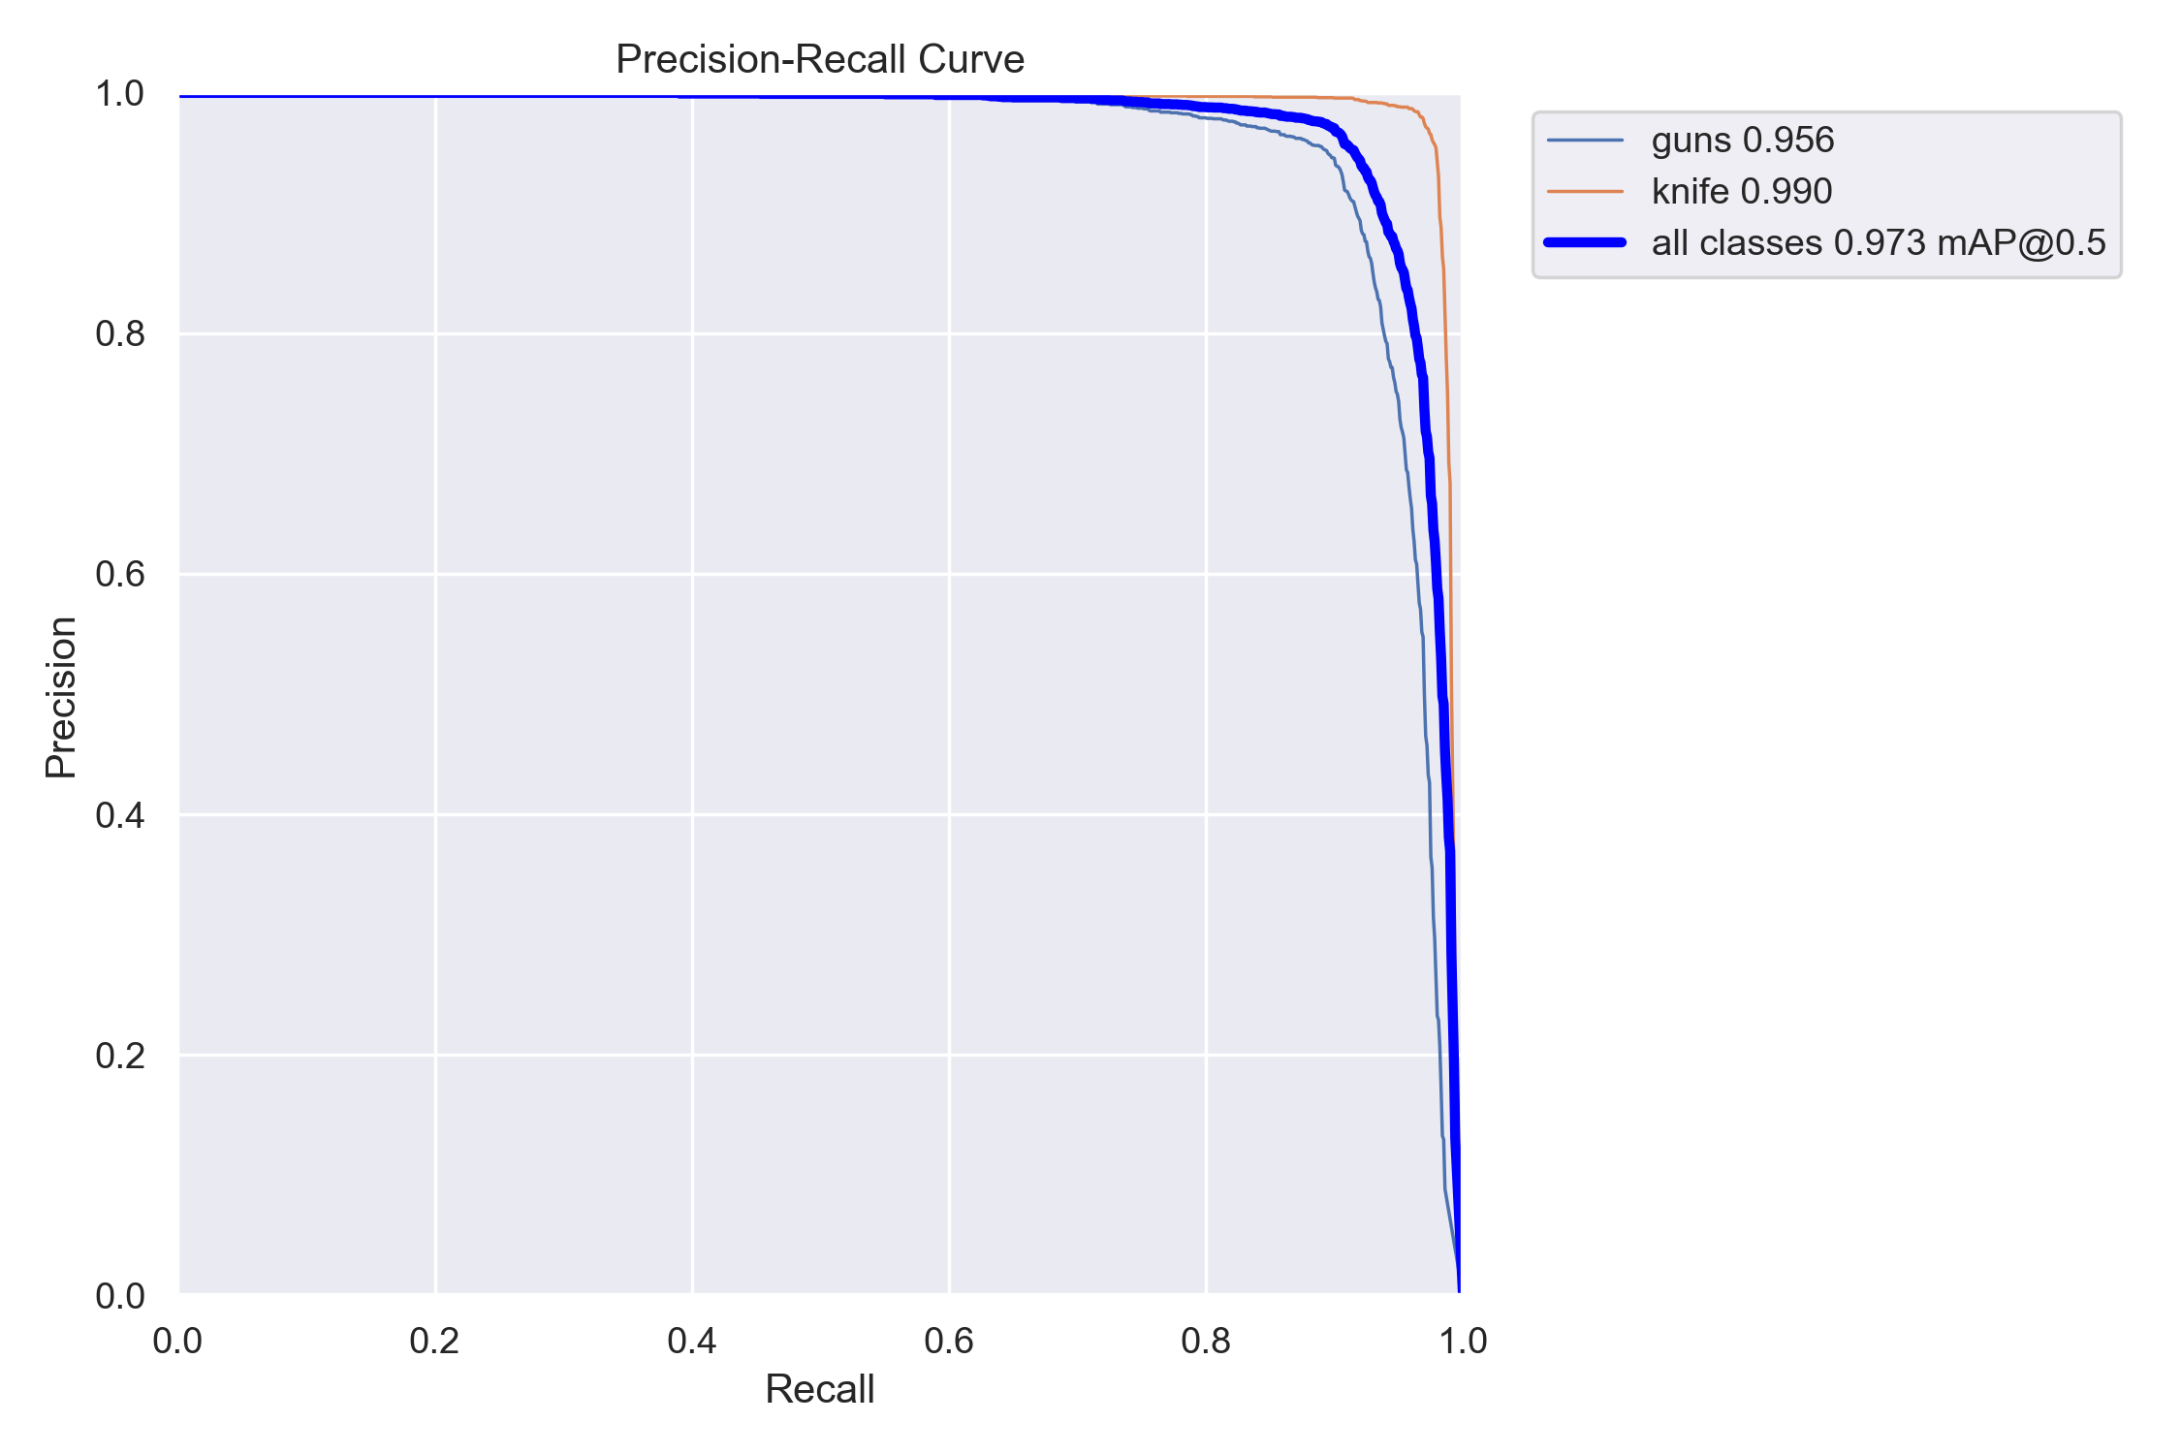
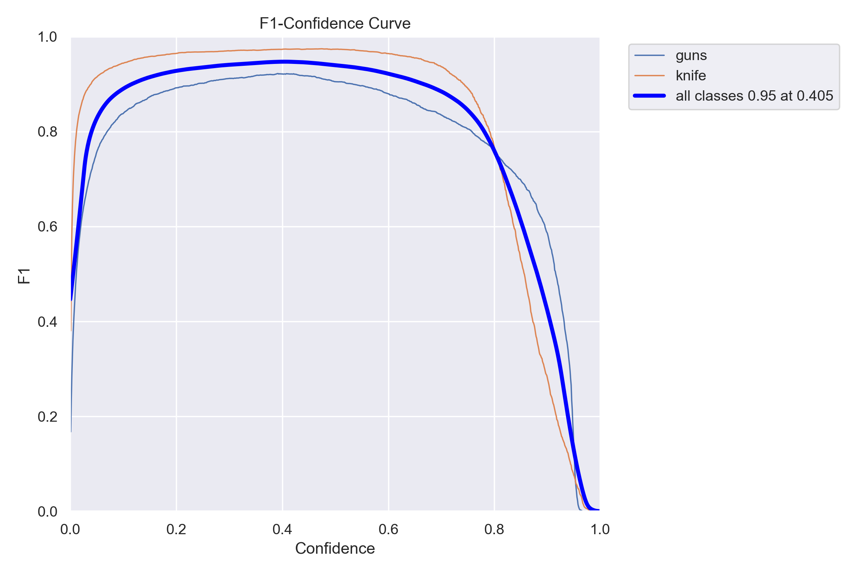
RESULTS
Precision-Recall and F-1 Curves for weapon Detection:
:

Slide 14
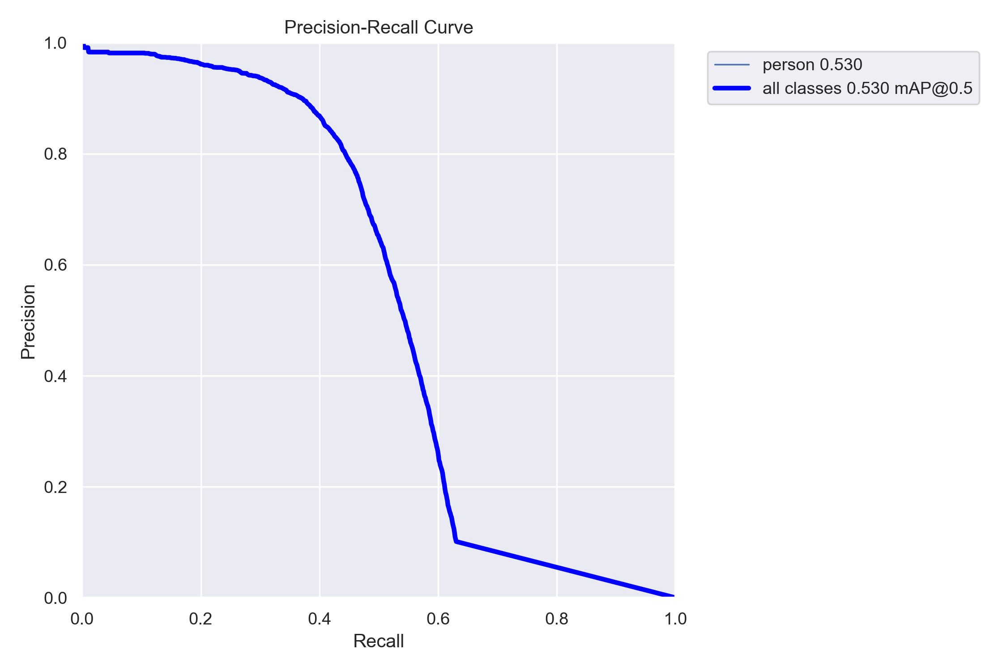
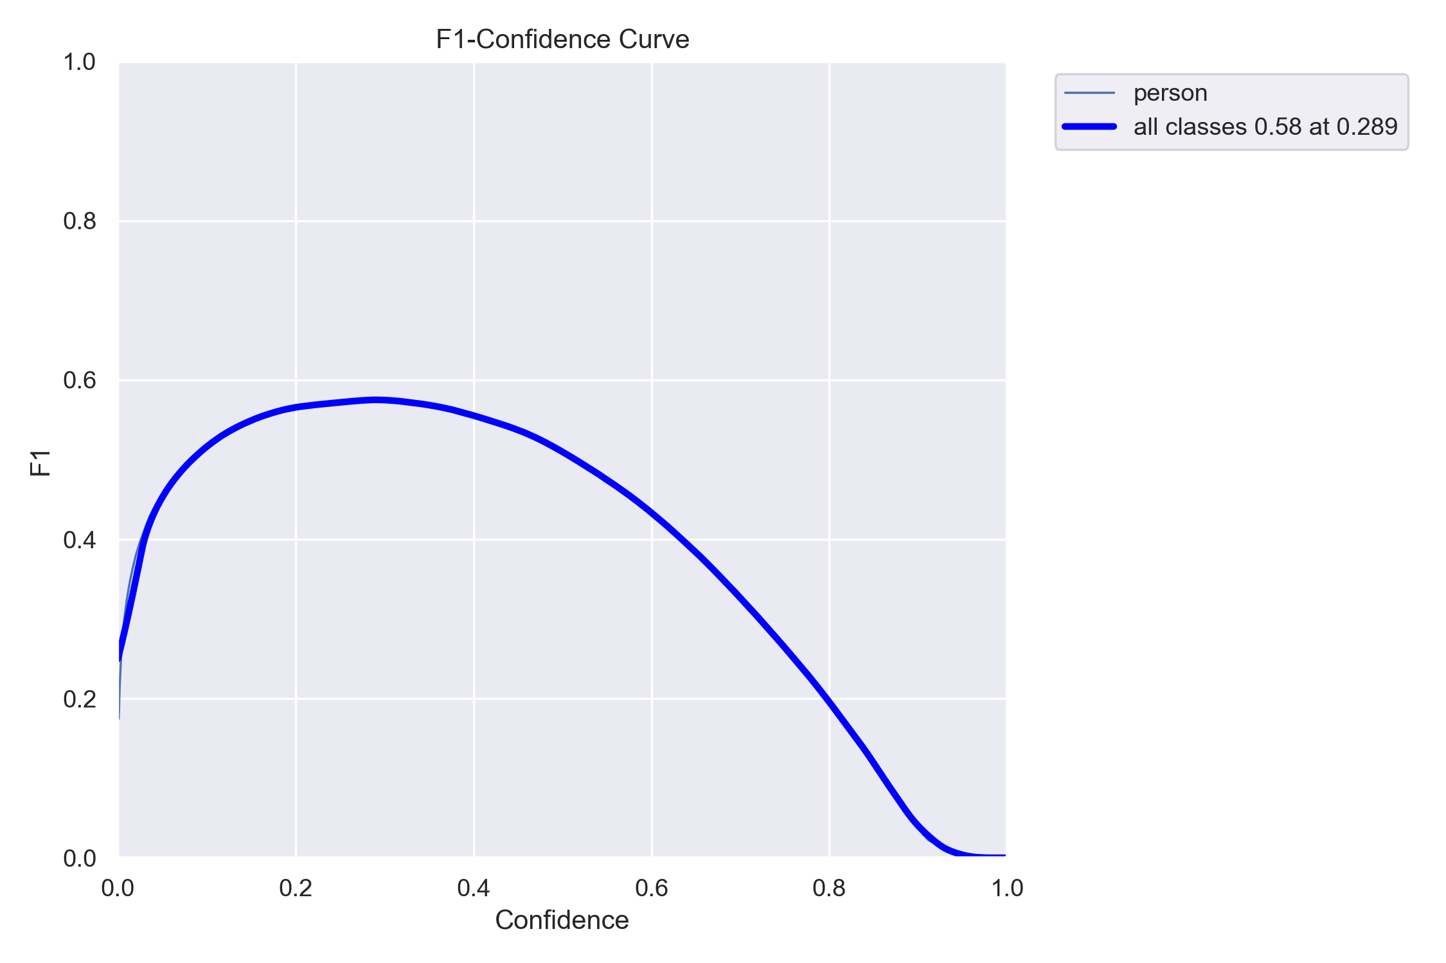
RESULTS
Precision-Recall and F-1 Curves for Persons Detection:

Slide 15
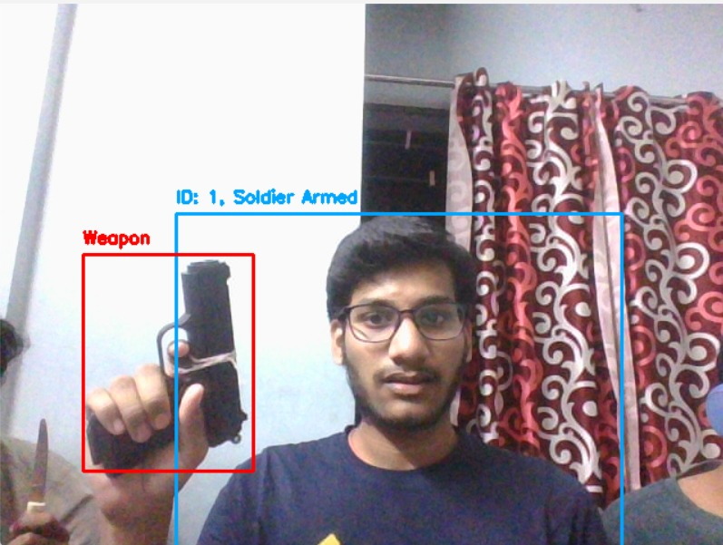
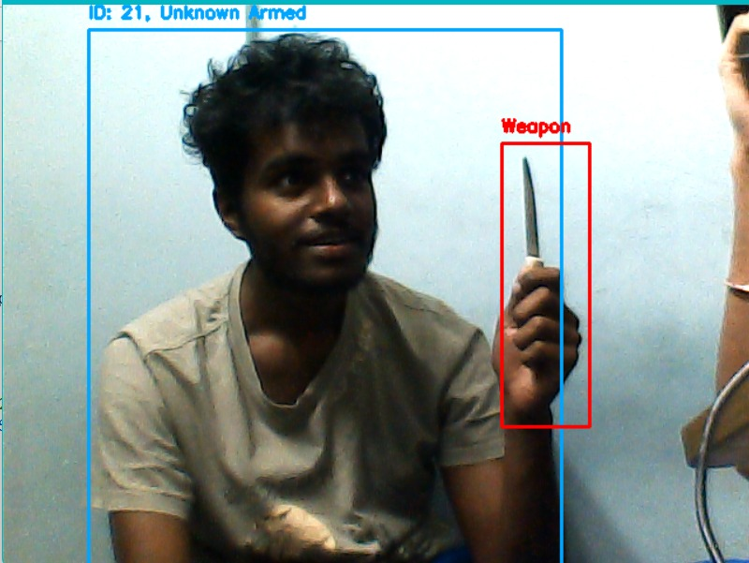
RESULTS
OUTPUTS:

Slide 16
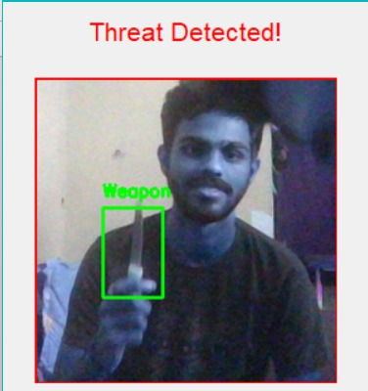
RESULTS
OUTPUTS: Pop Up notification of threat detection

Slide 17
FUTURE WORK
1. Enhanced Weapon Detection
Objective: Improve detection accuracy for small or camouflaged weapons.
Approach:
Utilize advanced models like Transformer-based detectors.
Expand training datasets to include edge cases, such as concealed or partially visible weapons
2.System Expansion
Objective: Extend system capabilities to handle additional objects and threats.
Approach:
Add detection for other items such as explosives or contraband.
Enhance multi-camera systems for broader surveillance coverage.
3. Environmental Adaptation
Weather-Resilient Models:
Train models to work effectively in extreme weather conditions, such as rain, snow, or sandstorms.
Adaptation to Dynamic Settings:
Incorporate continuous learning mechanisms to adapt the system to evolving scenarios in real time.
.

Slide 18
CONCLUSION
We have developed a model which is capable of real-time weapon detection and person classification.
Integrated multi-camera tracking to enhance surveillance coverage and response efficiency.
Achieved high performance with 92% precision and 91% recall for weapon detection.
Weapon detection achieved a precision of 92% and recall of 89% and for Person classification achieved a precision of 91% and recall of 89%.
User-Friendly Interface: Outputs include real-time overlays and alert notifications for easy interpretation.
With stronger computational power and continuous improvements, our model can serve as a benchmark for modern AI-driven surveillance solutions.

Slide 19
REFERENCES
1) Weapon Detection Using Deep learning model and Artificial Intelligence [2023][ZKG INTL] By Datla Mehar Chaitanya Sagar, Y.Rajesh 2) S. Khalid, A. Waqar, H. U. Ain Tahir, O. C. Edo and I. T. Tenebe, "Weapon detection system for surveillance and security," 2023 International Conference on IT Innovation and Knowledge Discovery (ITIKD), Manama, Bahrain, 2023, pp. 1-7, doi: https://10.1109/ITIKD56332.2023.10099733 3) Real Time Crime Detection By Captioning Video Surveillance Using Deep Learning [2023][IJRCT] By Nagesh Nayak, Shlesha Odhekar, Sapna Patwa, Sukanya Roy Chowdhury 4) S. Tanjila Naurin, A. Saha, K. Akter and S. Ahmed, "A Proposed Architecture to Suspect and Trace Criminal Activity Using Surveillance Cameras," 2020 IEEE Region 10 Symposium (TENSYMP), Dhaka, Bangladesh, 2020, pp. 431-435, doi: https://10.1109/TENSYMP50017.2020.9230901

Slide 20
THANK YOU

